Slide 1

QCML Course Lab Session - 02
By Aniket,
Indian Institute of Technology Delhi

Slide 2
What we have done so far…
Installation Guide (New)
Introduction to Python (Tutorial)
IBM Quantum Experience

Slide 3
What we will do today…
Basics of Quantum Mechanics
Introduction to Qiskit
Introduction to Quantum Circuits
More about IBM Quantum Platform

Slide 4
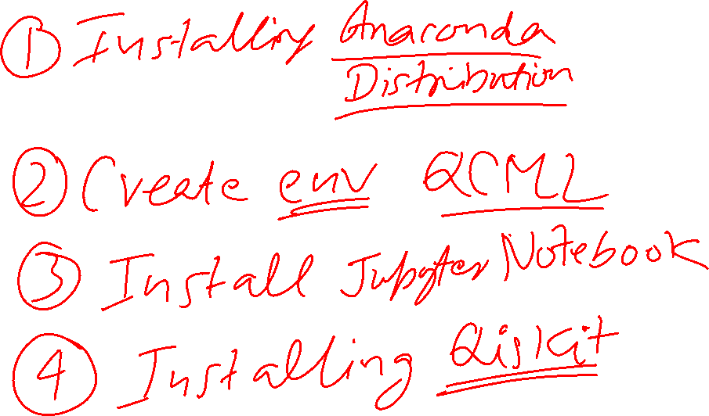

Slide 5
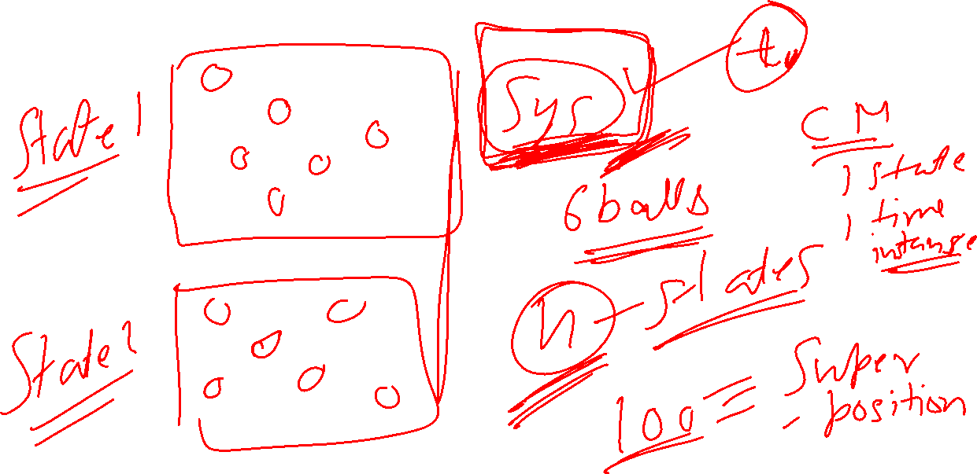

Slide 6
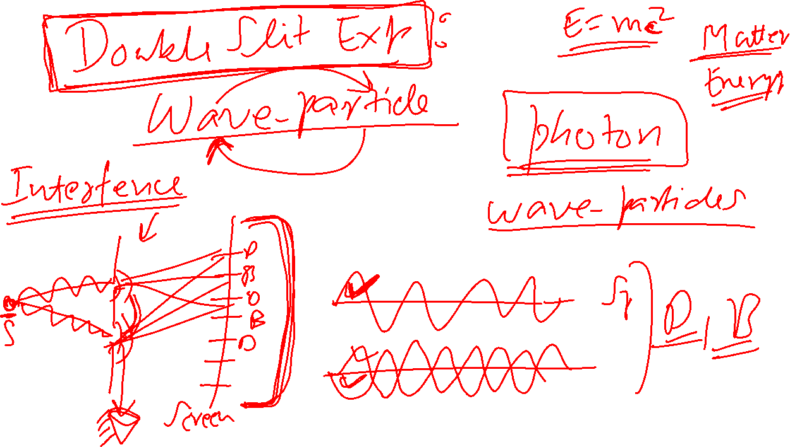

Slide 7
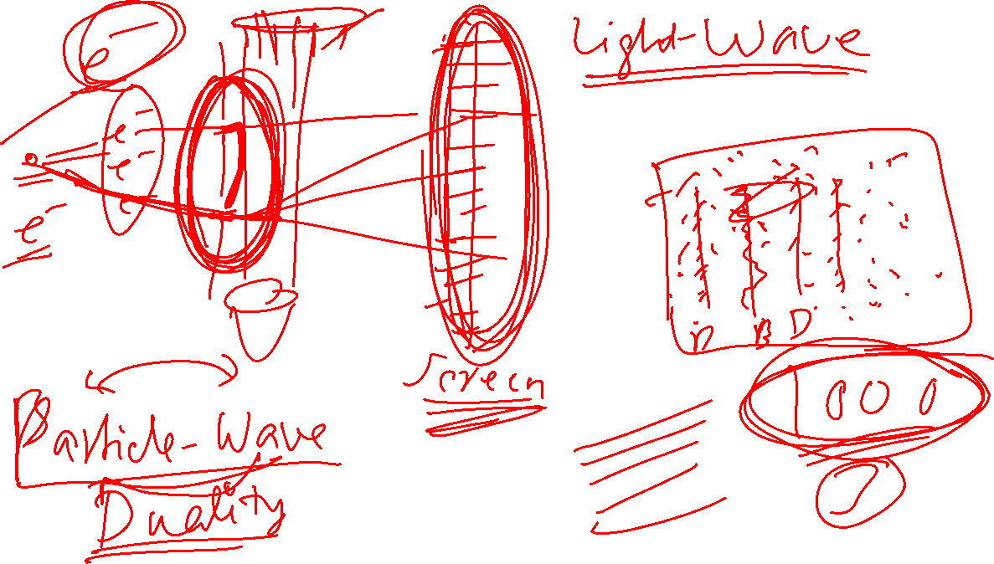

Slide 8
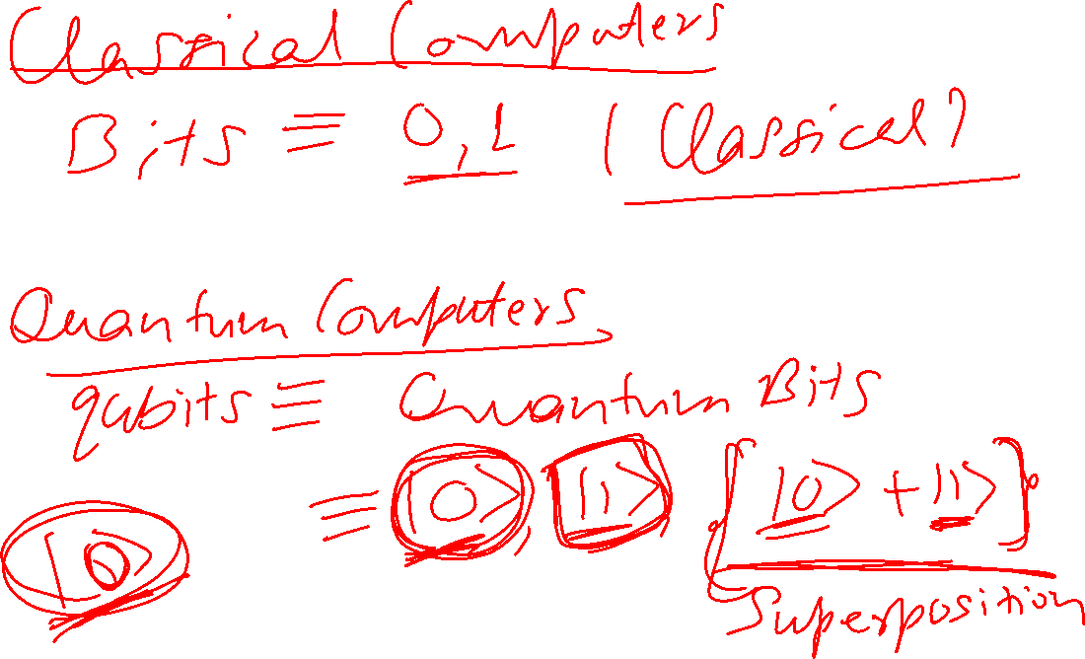

Slide 9
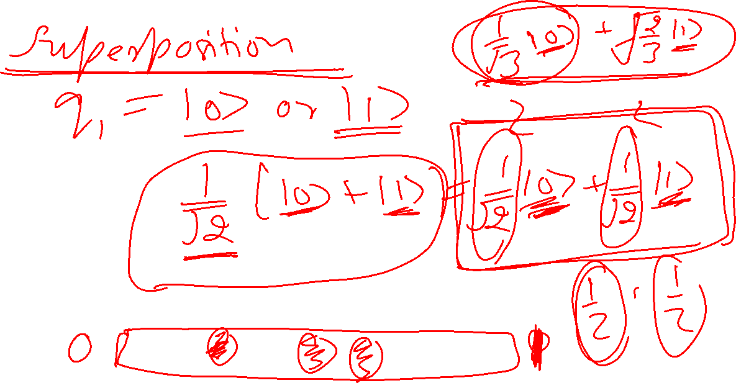

Slide 10
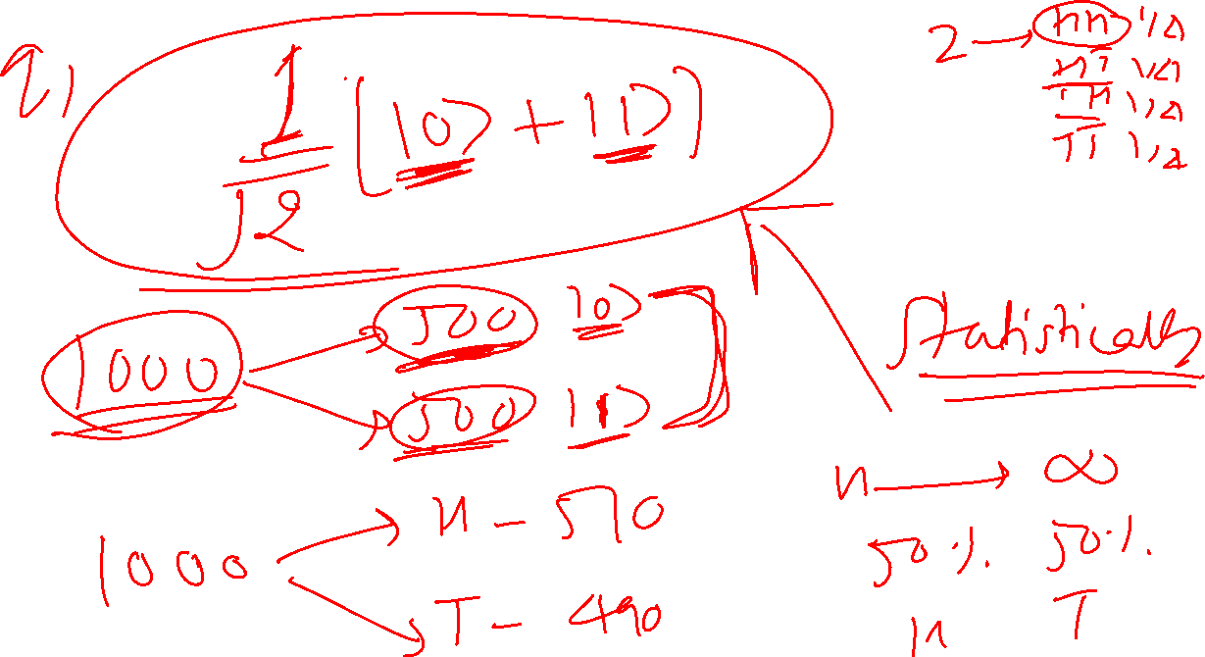

Slide 11






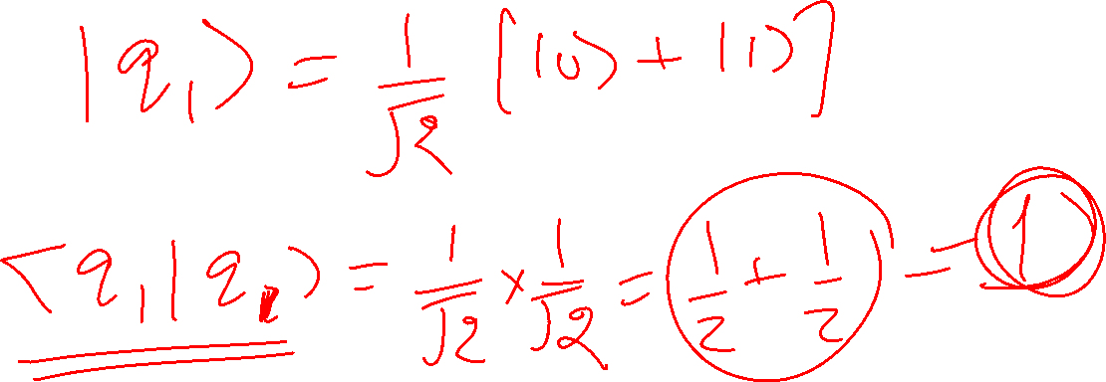









Slide 12
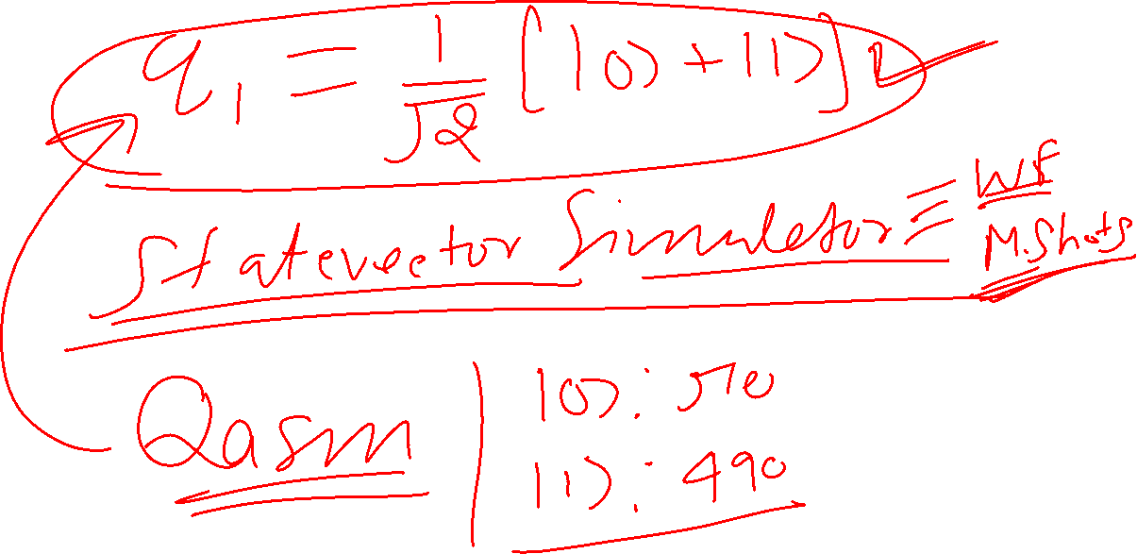

Slide 13
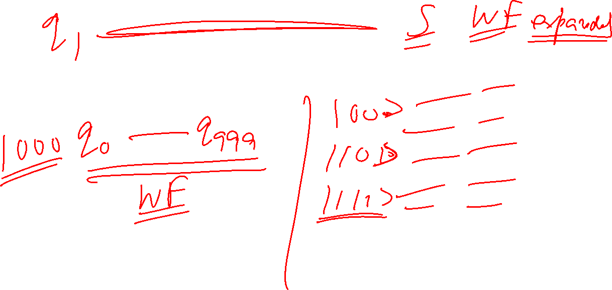

Slide 14
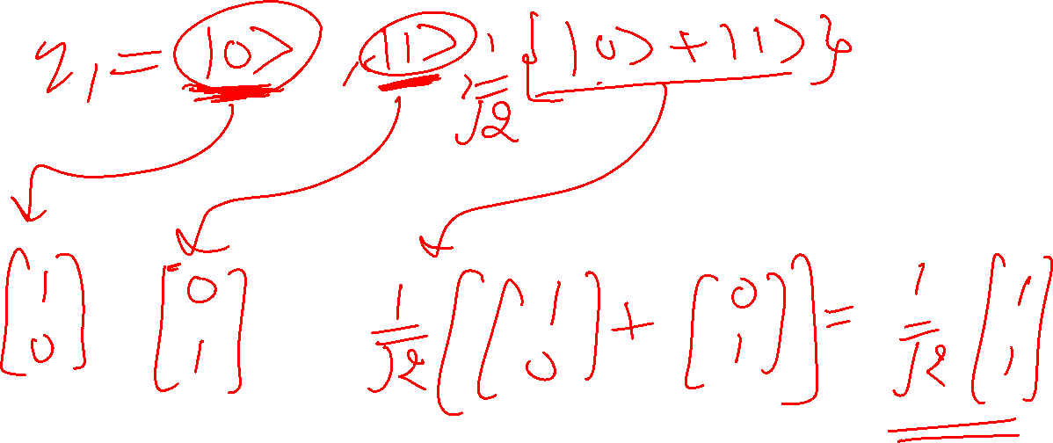

Slide 15
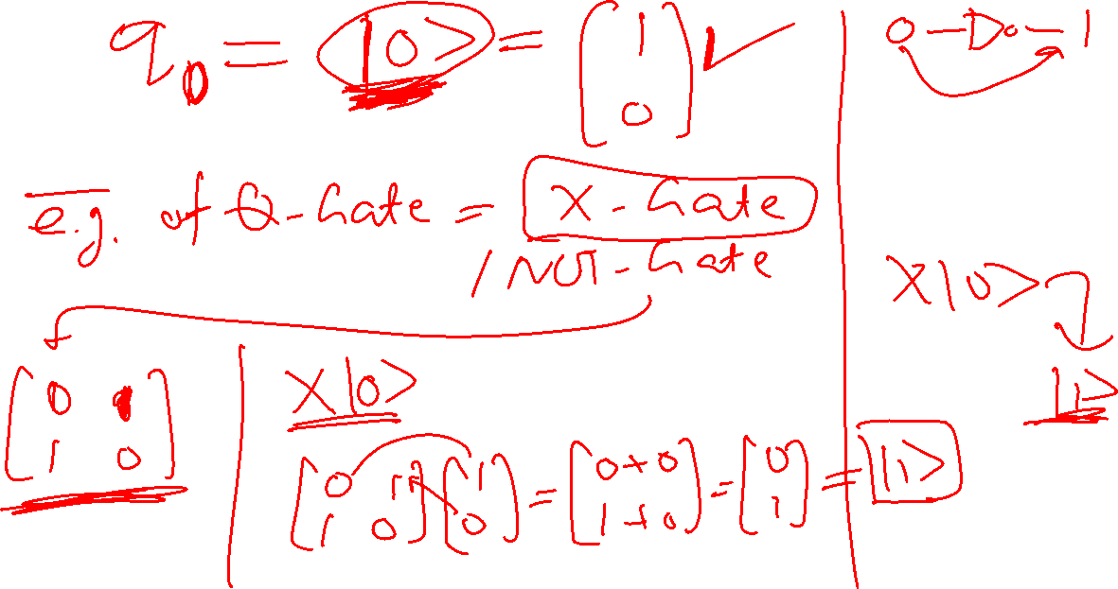

Slide 16
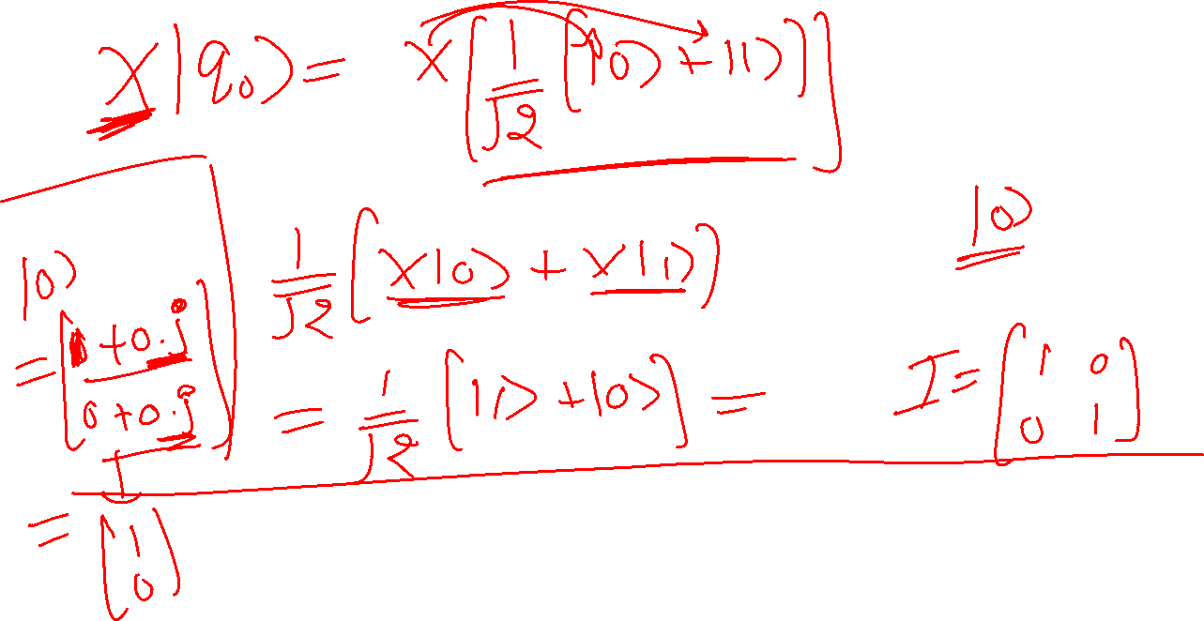

Slide 17
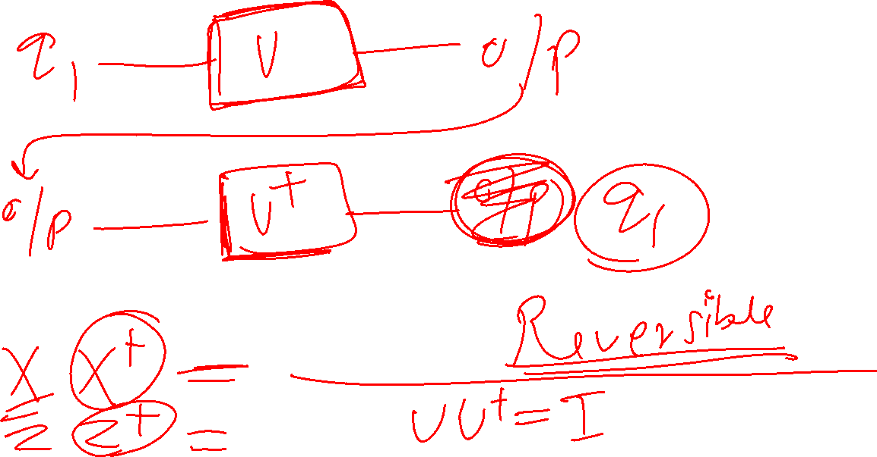

Slide 18
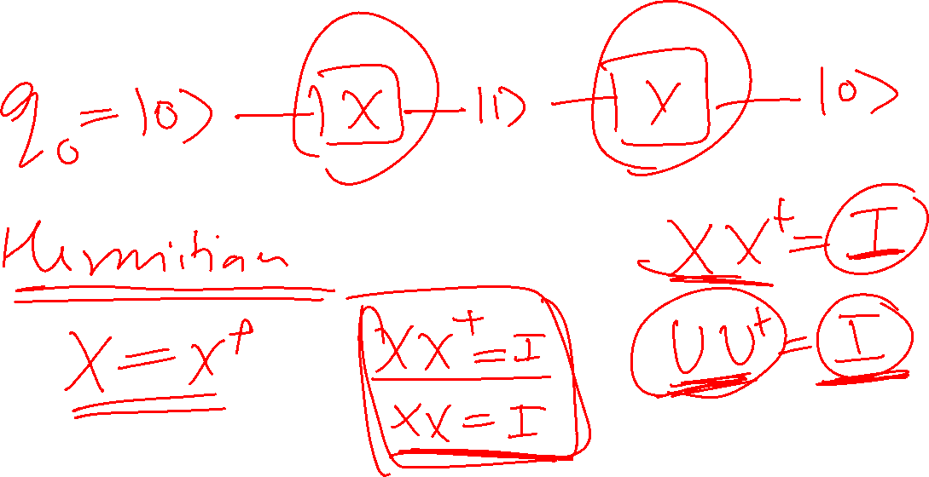

Slide 19
